Slide 1
Introduction to Digital Electronics

Slide 2
Lecture 9 Digital Codes
Lecture delivered by:
Deepak V.

Slide 3
Objectives
At the end of this lecture, student will be able to:
Acquire the knowledge of Binary Coded Decimal
Describe Multibit BCD
Acquire the knowledge of ASCII Code
Differentiate the number system

Slide 4
Topics
Binary Coded Decimal
Multibit BCD
ASCII Code
Comparison of number system

Slide 5
Binary Coded Decimal (BCD)
Would it be easy for you if you can replace a decimal number with an individual binary code
Such as 00011001 = 19₁₀
The 8421 code is a type of BCD to do that
Each of the 10 decimal digits is represented by its 4-bit binary equivalent

Slide 6
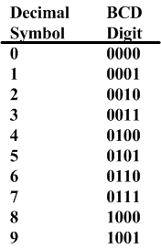
Decimal and BCD
The BCD is simply the 4 bit representation of the decimal digit
For multiple digit base 10 numbers, each symbol is represented by its BCD digit
What happened to 6 digits not used?

Slide 7
BCD operation
Consider the following BCD operation
Decimal: Add 4 + 1
Covert to binary 0 1 0 0
And 0 0 0 1
Getting 0 1 0 1
Which is still a BCD representation of a decimal digit

Slide 8
BCD operation
A second example
3 0 0 1 1
+3 0 0 1 1
Getting 6 or 0 1 1 0
And in range and a BCD digit representation

Slide 9
BCD operation
Consider 5 + 5
5 0 1 0 1
+5 0 1 0 1
giving 1 0 1 0 which is binary 10 but not a BCD digit!
What to do?
Try adding 6??
Adding 6
Had 1010 and want to add 6 or 0110
so 1 0 1 0
plus 6 0 1 1 0
Giving 1 0 0 0 0
Or a carry out to the next binary digit, or if the binary in BCD, the next BCD digit

Slide 10
BCD operation
Add 7 + 6
have 7 0 1 1 1
plus 6 0 1 1 0
Giving 1 1 0 1 and again out of range
Adding 6 0 1 1 0
Giving 1 0 0 1 1 so a 1 carries out to the next BCD digit
FINAL BCD answer 0001 0011 or 13₁₀

Slide 11
Multibit BCD
Add the BCD for 417 to 195
Would expect to get 612
BCD setup - start with Least Significant Digit
0 1 0 0 0 0 0 1 0 1 1 1
0 0 0 1 1 0 0 1 0 1 0 1
1 1 0 0
Adding 6 0 1 1 0
Gives 1 0 0 1 0

Slide 12
Continuing multibit
Had a carry to the 2nd BCD digit position
1
0 1 0 0 0 0 0 1 done
0 0 0 1 1 0 0 1 0 0 1 0
1 0 1 1
Again must add 6 0 1 1 0
Giving 1 0 0 0 1
And another carry

Slide 13
Continuing multibit
Had a carry to the 3rd BCD digit position
1
0 1 0 0 done done
0 0 0 1 0 0 0 1 0 0 1 0
0 1 1 0
And answer is 0110 0001 0010 or the BCD for the base 10 number 612

Slide 14
The ASCII Code
ASCII (American Standard Code for Information Interchange) is a binary code for alphanumeric symbols
ASCII encodes 128 symbols using 7-bits
See Table 1-5 on page 19 (next slide) for the list of ASCII codes
The first 32 symbols are control characters (such as Backspace, Line Feed, Form Feed), based on teletype requirements. Some of these are obsolete

Slide 15
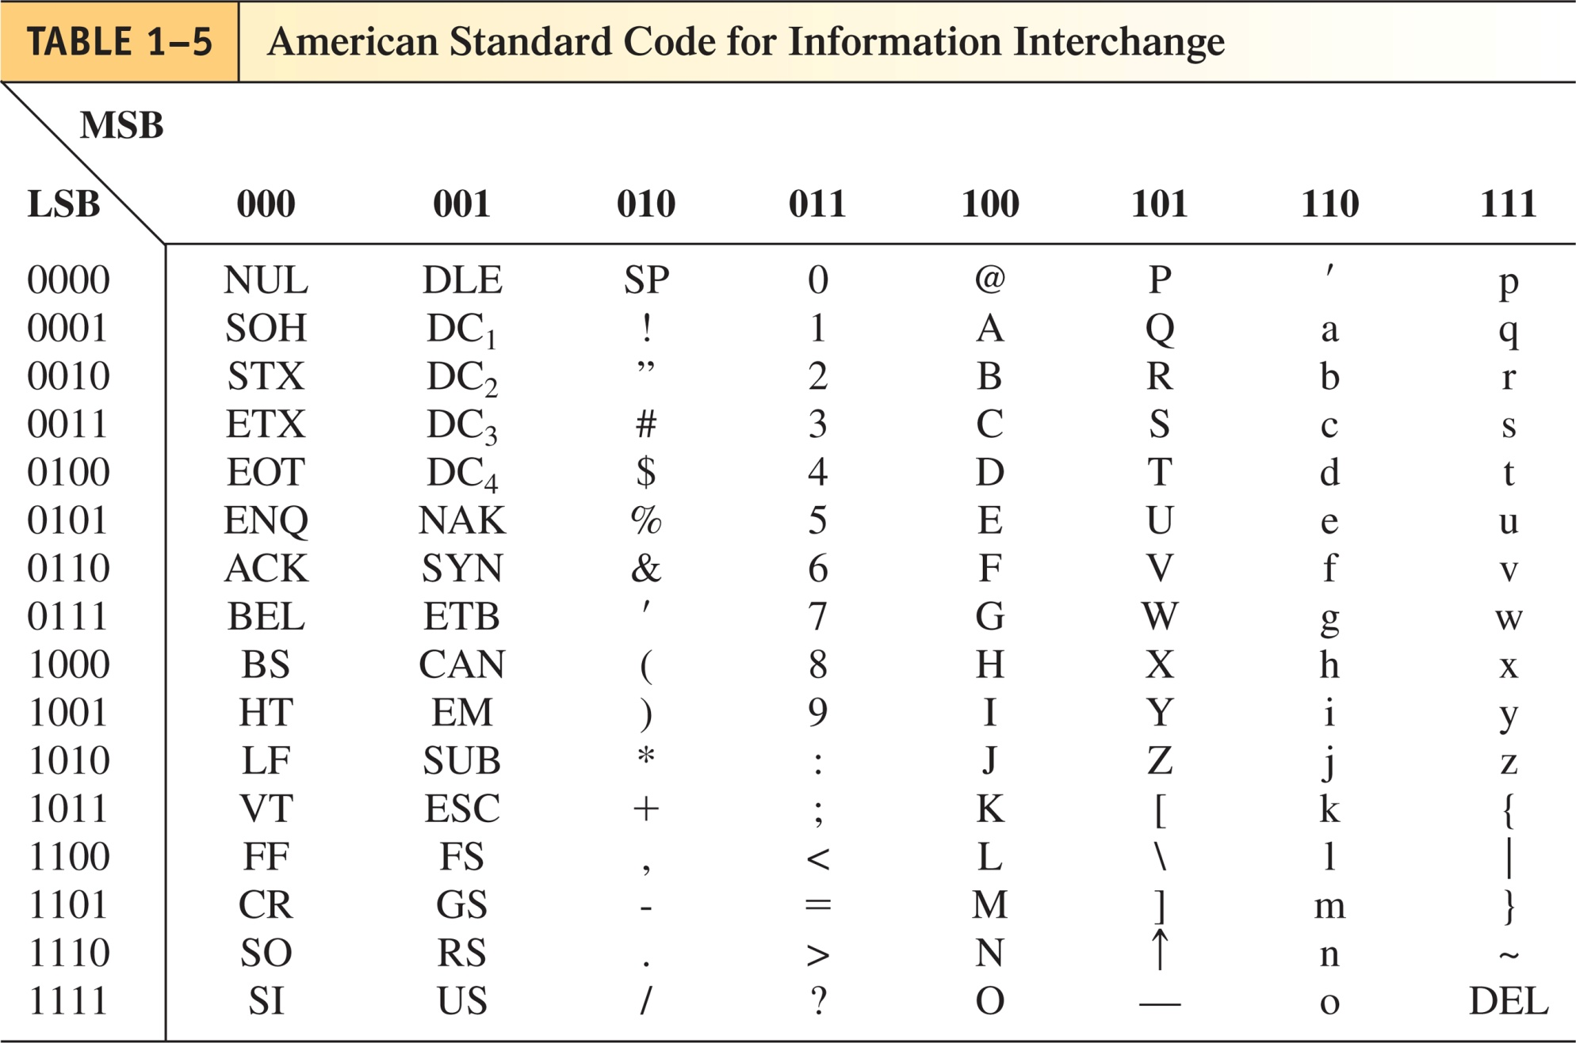
The ASCII Code
Table: ASCII Code

Slide 16
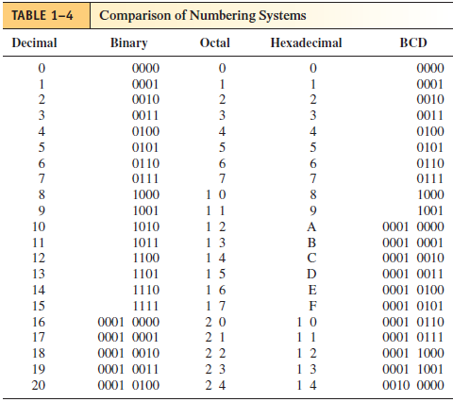
Comparison of number system

Slide 17
Summary
Each of the 10 decimal digits is represented by its 4-bit binary equivalent
The BCD is simply the 4 bit representation of the decimal digit
ASCII (American Standard Code for Information Interchange) is a binary code for alphanumeric symbols
ASCII encodes 128 symbols using 7-bits.

